Slide 1
Saint Mary Univeristy Selected Topics : K-Means Clustring

Slide 2
TABLE OF CONTENTS
01
02
03
04
What is Clustering algorithm ?
What is K-Means Clustering ?
How K-Means Clustering works ?
How we collected the data ?
05
Show case and challenges
References
06

Slide 3
01
Clustering algorithm

Slide 4
Clustring Algorithm
A clustering algorithm is a type of unsupervised learning method used to group similar data points into clusters. These algorithms aim to identify patterns or structures within data without pre-labeled categories, allowing for natural grouping based on the inherent characteristics of the data.

Slide 5
K-Means Clustering
02

Slide 6
K-Means Clustring
K-Means Clustering is a popular and simple clustering algorithm that partitions data into K distinct, non-overlapping clusters. Each data point is assigned to the cluster with the nearest mean, which serves as the cluster's centroid. The objective is to minimize the total variance within each cluster.

Slide 7
How K-Means Clustering Works
03

Slide 8
1.Initialization: Select K initial centroids randomly.
2.Assignment: Assign each data point to the nearest centroid, forming K clusters.
3.Update: Calculate new centroids as the mean of all points in each cluster.
4.Repeat: Reassign data points to the nearest centroid and update the centroids iteratively until convergence, meaning the centroids no longer change significantly.

Slide 9
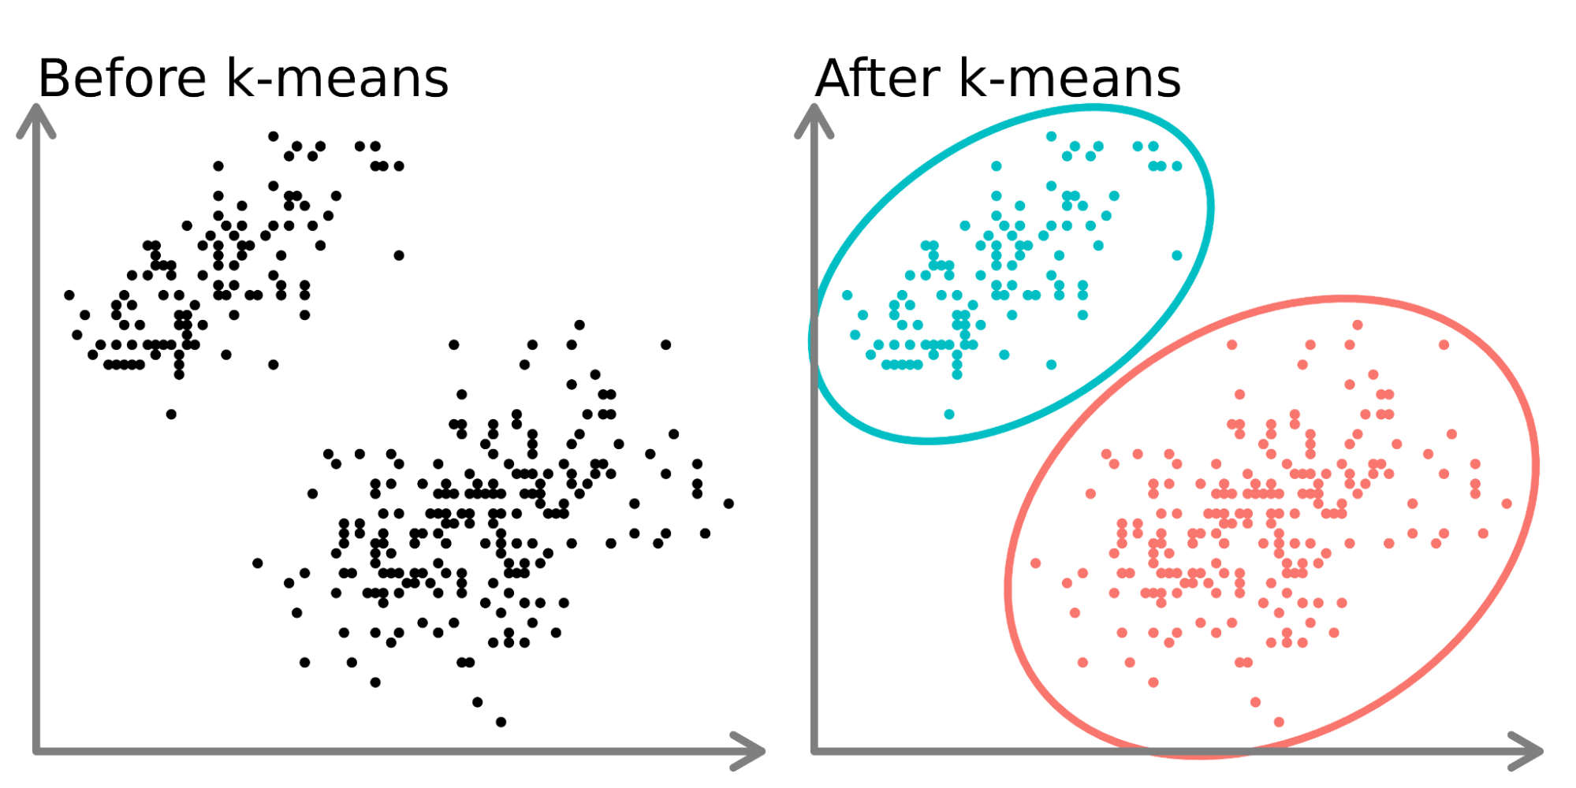

Slide 10
How We Collected the Data?
04

Slide 11
The data was collected from a dataset named "housing.csv," which contains information about housing units. The dataset includes features such as longitude, latitude, housing median age, total rooms, total bedrooms, population, households, median income, median house value, and ocean proximity. The data was pre-processed to handle missing values, normalize features, and ensure quality for clustering analysis.

Slide 12
05
Showcase and Challenges We Faced

Slide 13
Showcase: We applied K-Means Clustering to segment customers based on purchasing behavior, allowing for targeted marketing strategies.

Slide 14
Challenges:
Choosing the Right K: Determining the optimal number of clusters (K) was challenging and required techniques like the Elbow Method or Silhouette Analysis.
Handling Outliers: Outliers can skew the clustering results, making it essential to preprocess and possibly remove outliers.
Scalability: Processing large datasets required efficient computation and sometimes dimensionality reduction techniques to improve performance.

Slide 15
References
06
https://www.kaggle.com/datasets/shwetabh123/mall-customers
https://www.datacamp.com/tutorial/k-means-clustering-python

